Slide 1


JOB EXPLORER
A WAY TO FIND NEW CARREER
ROLLNO | NAME
2451-15-733-136 2451-15-733-149 2451-15-733-148 | T sai hemanth G srihari R rajeshekar

Slide 2
FEATURES
You can choose any location and know the job vacancies in that area
After logging in the app,you can upload your resume
You can send your resume to any company ,if the company requirements meet your qualifications
Your uploaded resume can be seen by companies

Slide 3
HOW THIS APP IS DIFFERENT FROM OTHER
Easy search because all the jobs are divided into different catagories
This app brings all the job openings listed in the top career sites under one app
This app gives you suggestions on jobs based on your resume

Slide 4
REQUIREMENTS
HARDWARE REQUIREMENTS :
Pentium processor ------------- 233 MHZ or above
RAM capacity ------------- 128MB
SOFTWARE REQUIREMENTS :
operating system ----------- Windows 95/98/2000
front end ------------- Android studios
back end ----------- SQL

Slide 5
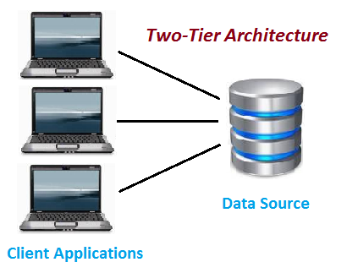
ARCHITECTURE

Slide 6
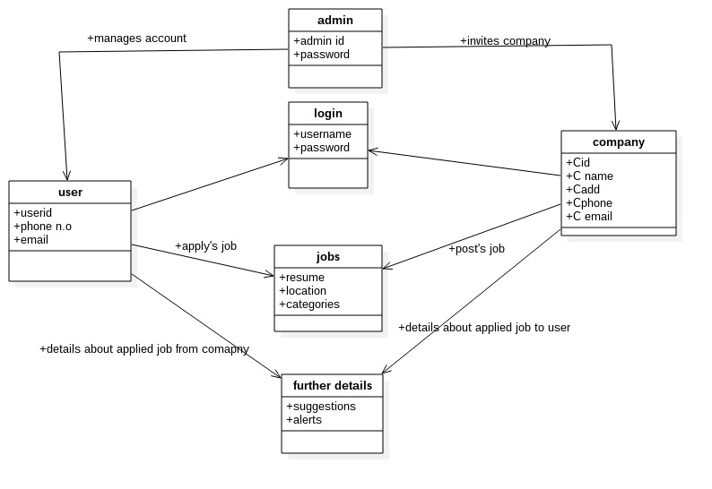
CLASS DIAGRAM

Slide 7
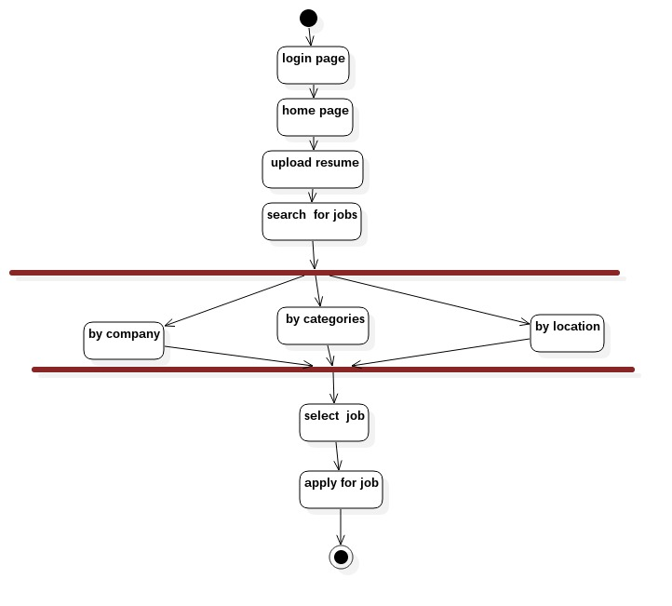
ACTIVITY DIAGRAM

Slide 8

USER CASE DIAGRAM

Slide 9
Thank you

